Slide 1
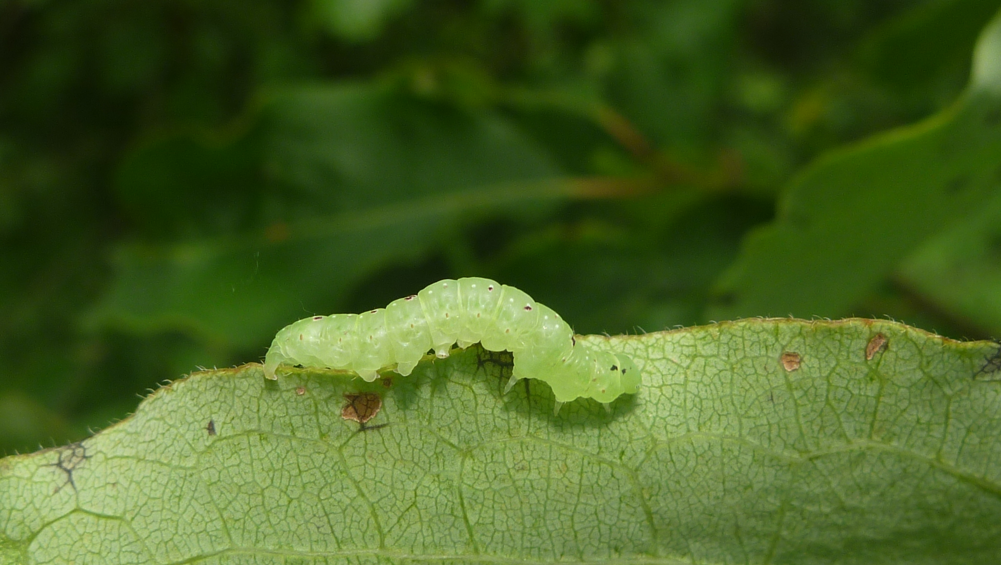
Caterpillars Count!
CITIZEN SCIENTISTS TRACKING THE PHENOLOGY OF BIRD FOOD
We’ll begin shortly!
Allen Hurlbert UNIVERSITY OF NORTH CAROLINA-CHAPEL HILL
WEBINAR OUTLINE
AND RESOURCES
http://tinyurl.com/CaterpillarsWebinar
Informational Webinar
Notes:
Today is all about discovering new ways to engage people at your sites. I’ve found that citizen science is a great way to get folks involved in science and in nature. People have an innate curiousity about the natural world, since they were little kids, and citizen science is a wonderful way for them to satisfy that curiosity and contribute to scientific research. At the same time, scientists are able to harness the power of so many more people than they usually would.

Slide 2
What is the origin of Caterpillars Count! ?
What can we learn from Caterpillars Count! ?
How can you participate?
WEBINAR OUTLINE
AND RESOURCES
http://tinyurl.com/CaterpillarsWebinar
Notes:
Today is all about discovering new ways to engage people at your sites. I’ve found that citizen science is a great way to get folks involved in science and in nature. People have an innate curiousity about the natural world, since they were little kids, and citizen science is a wonderful way for them to satisfy that curiosity and contribute to scientific research. At the same time, scientists are able to harness the power of so many more people than they usually would.

Slide 3




Slide 4

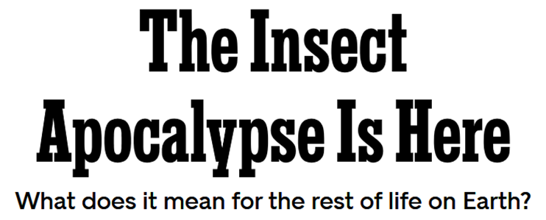
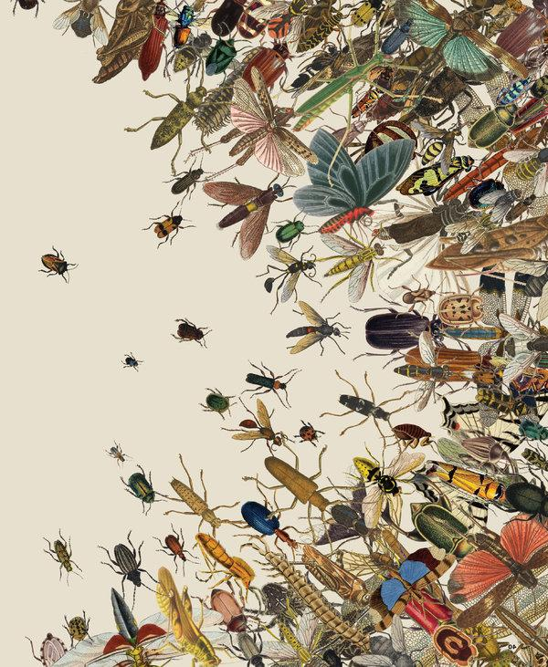
Nov 27, 2018
Dirzo et al. 2014, Science 345: 401

Slide 5
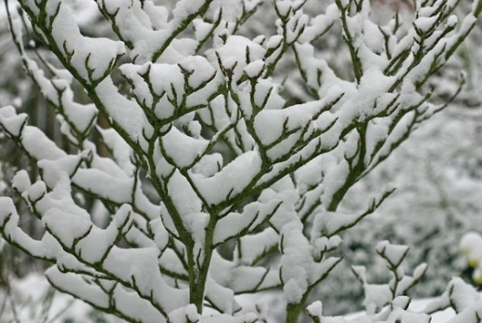
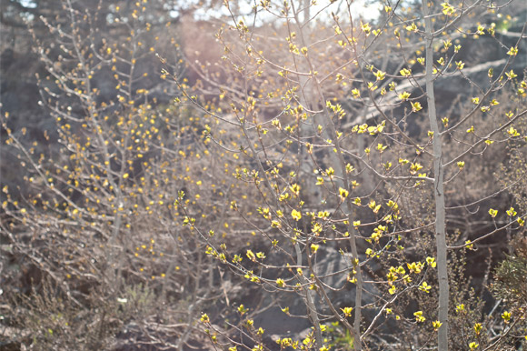
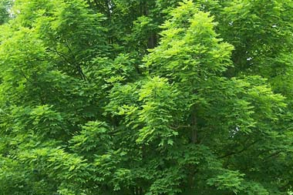
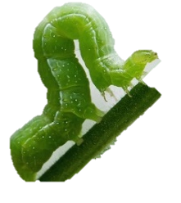
Nov 27, 2018
January
April
June

Slide 6
Nov 27, 2018
January
April
June
1) Are insects declining? Where? By how much?

Slide 7
Nov 27, 2018
January
April
June
1) Are insects declining? Where? By how much?
2) Are insects shifting their seasonal timing?

Slide 8
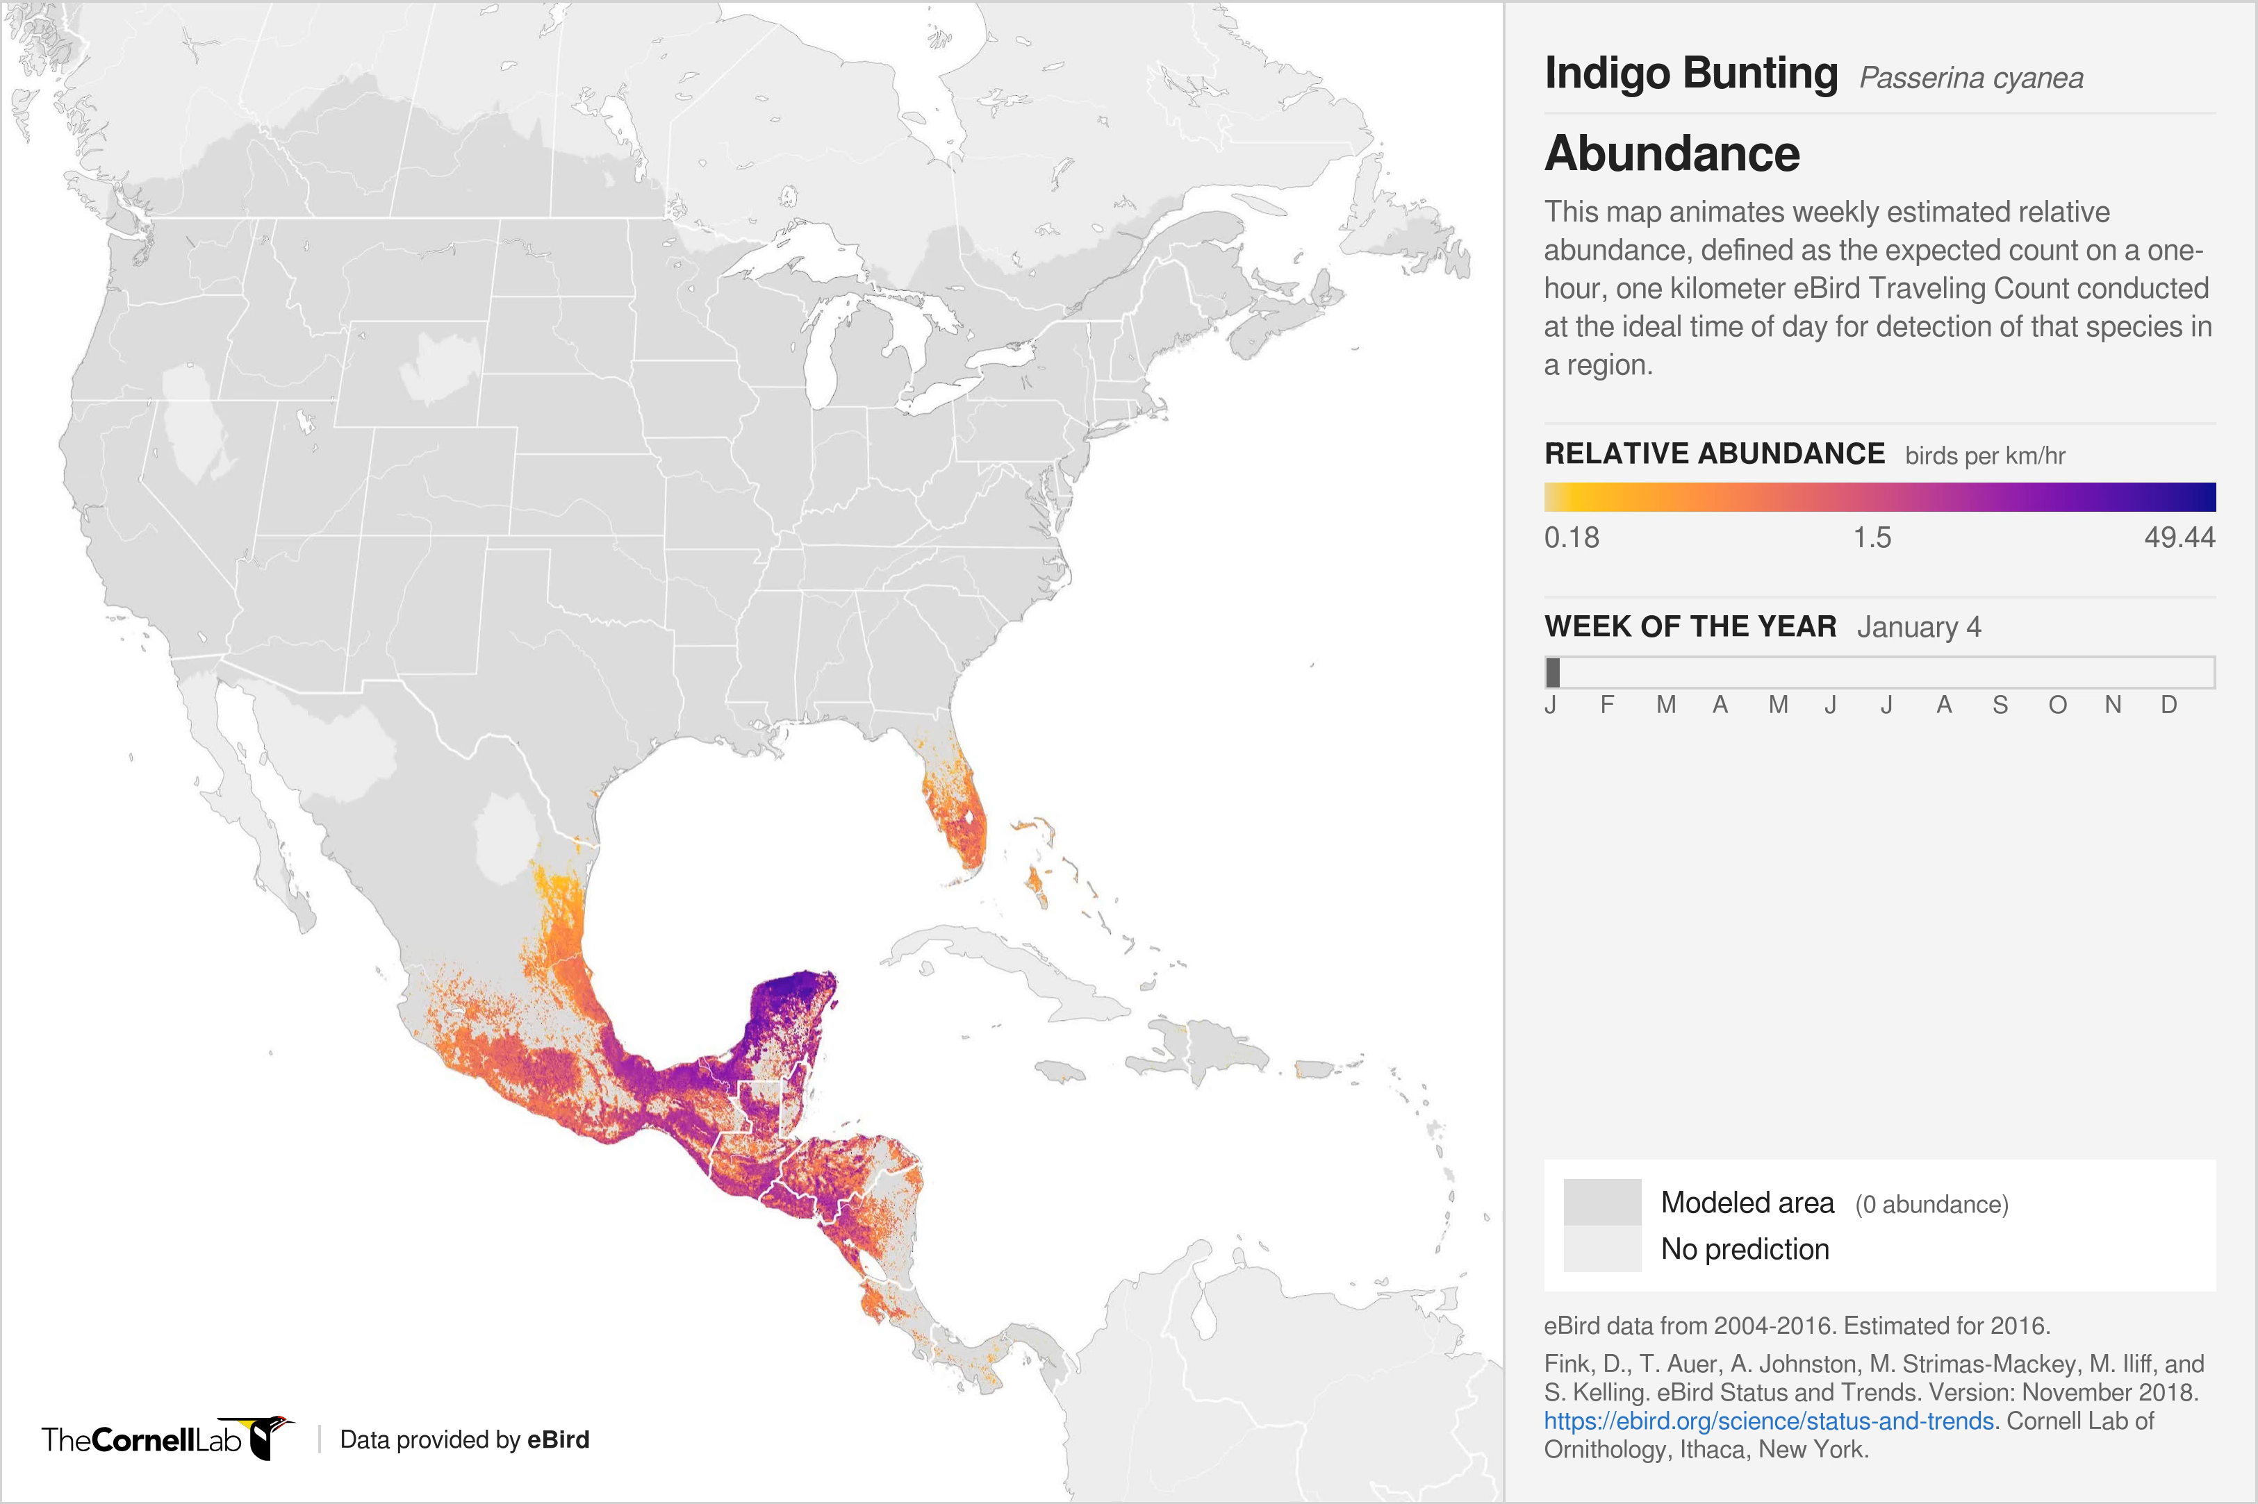
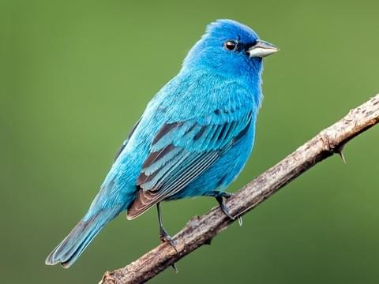
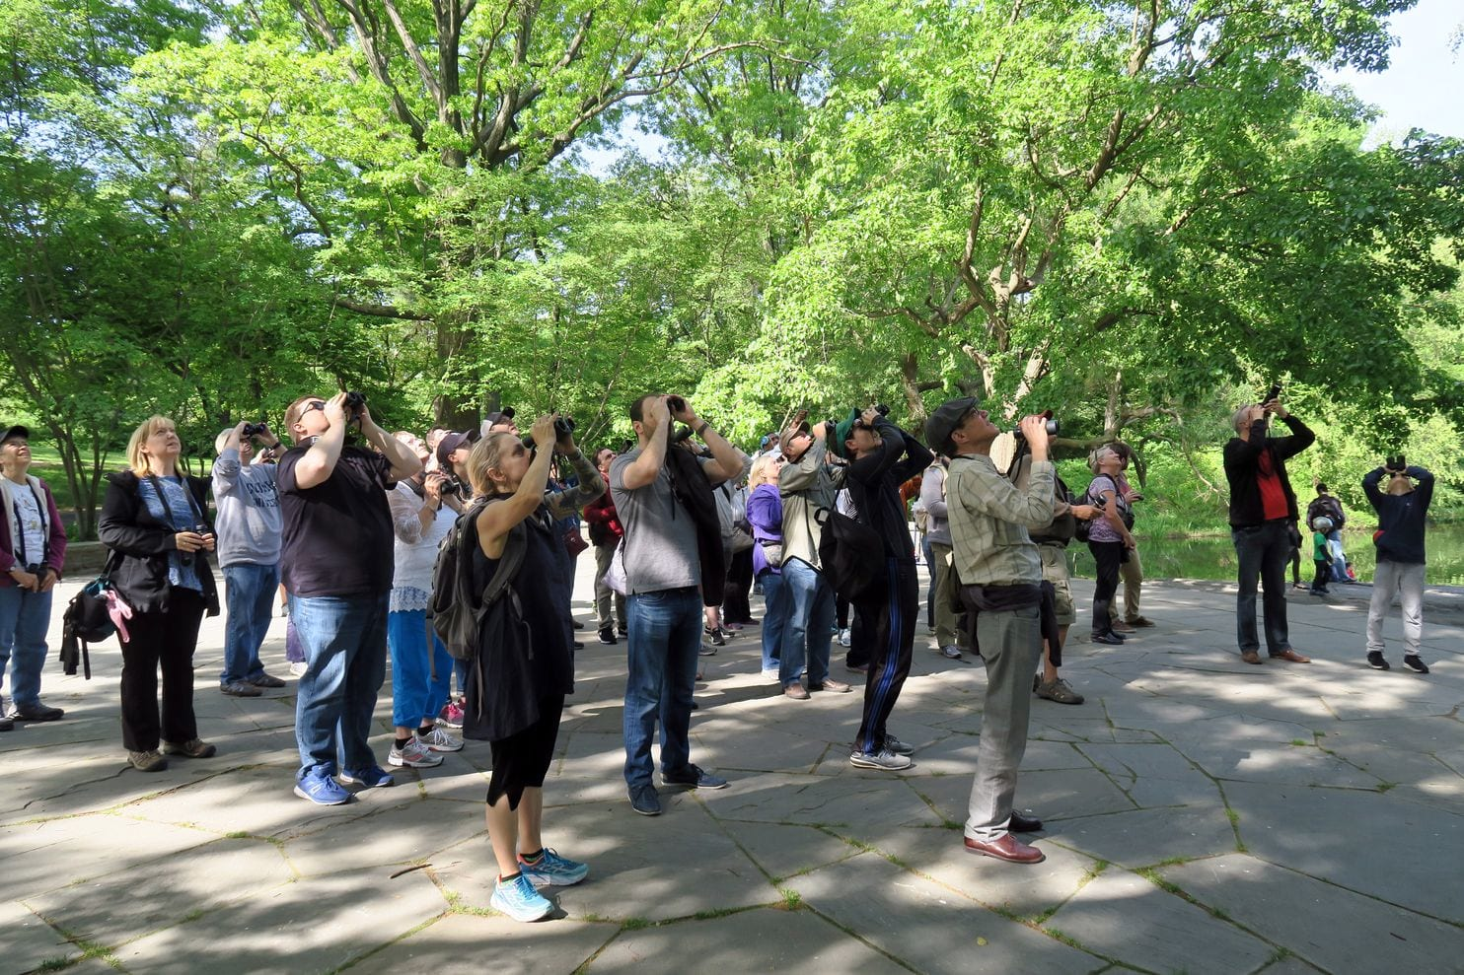

Slide 9
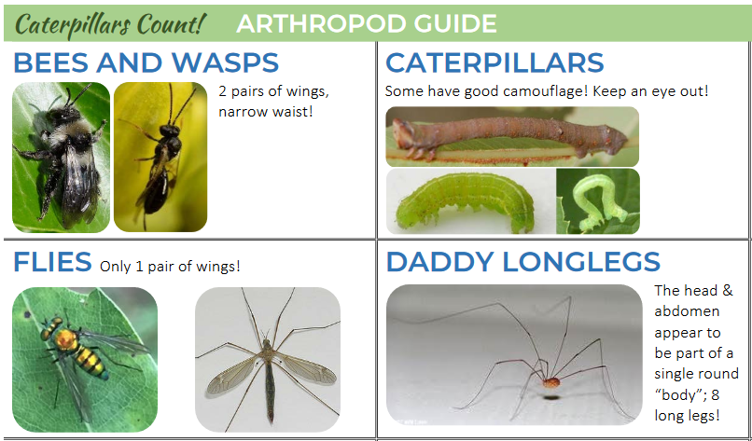
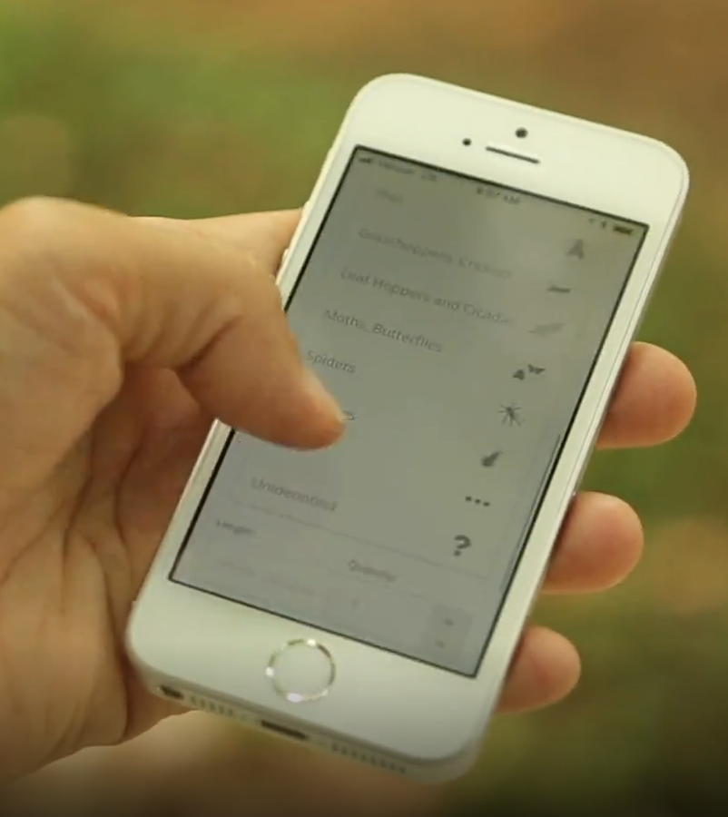
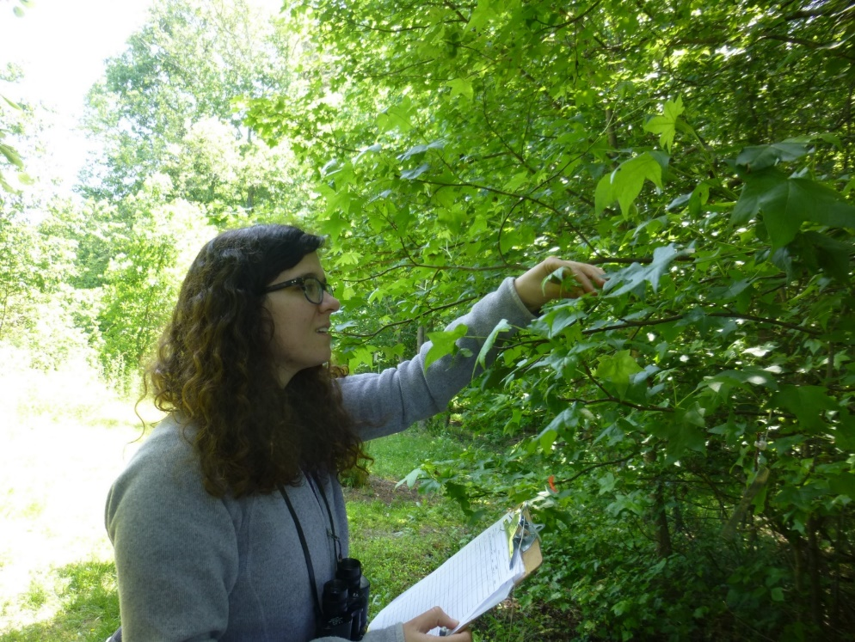
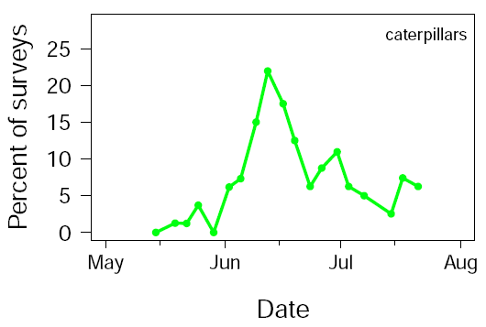

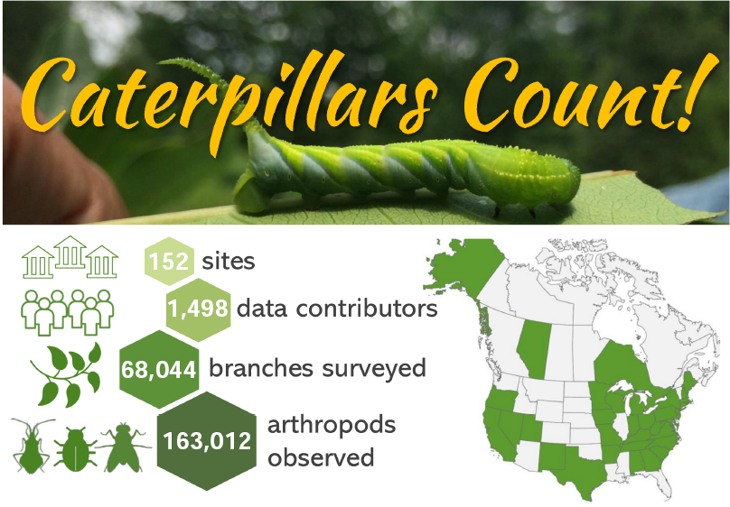
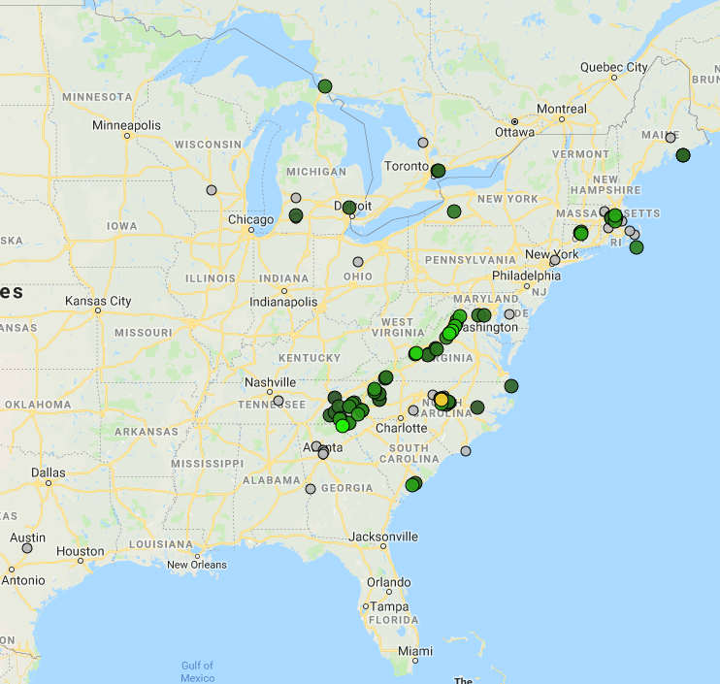
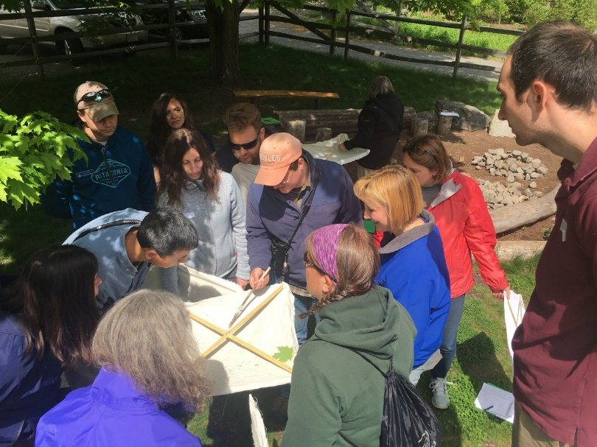
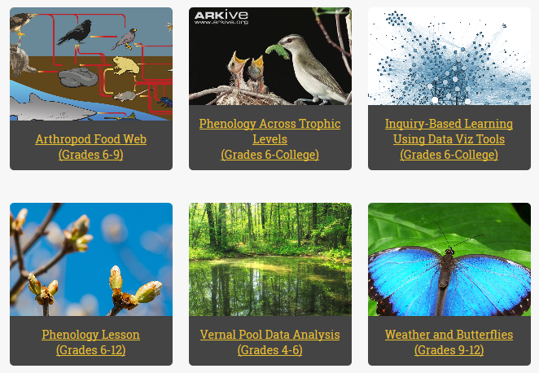
Training resources / mobile app
Conduct surveys
Data visualization tools
Peak date:
June 12
integration
caterpillarscount.unc.edu
Join us!
Nature centers /
school groups
Learning activities

Slide 10
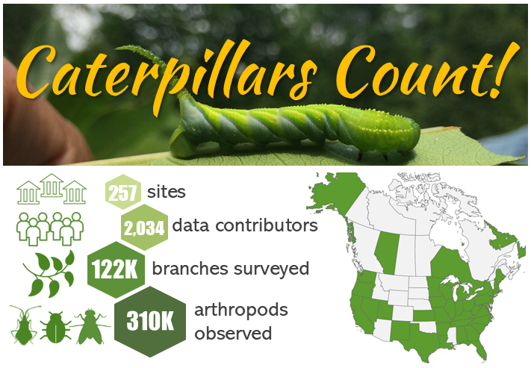

Slide 11
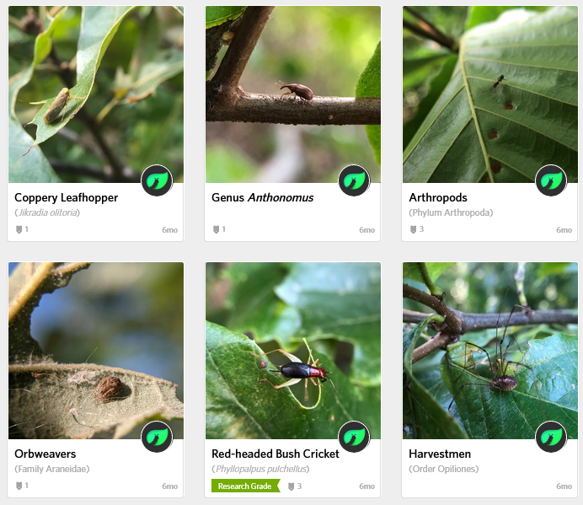
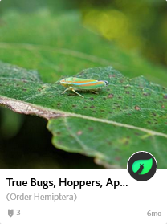
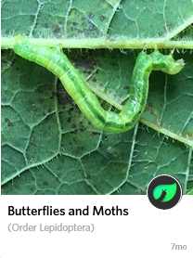
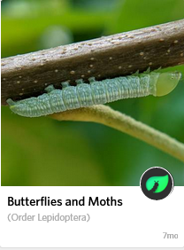
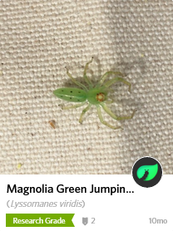
What have we learned?
Citizen scientists provide useful data on arthropod
composition, abundance, and phenology
Caterpillar occurrence
Date
Hurlbert et al. 2019, Citizen Science Theory & Practice

Slide 12
What have we learned?
Citizen scientists provide useful data on arthropod
composition, abundance, and phenology
r = 0.50
Caterpillar occurrence
Caterpillar occurrence
Date
Date
Hurlbert et al. 2019, Citizen Science Theory & Practice

Slide 13
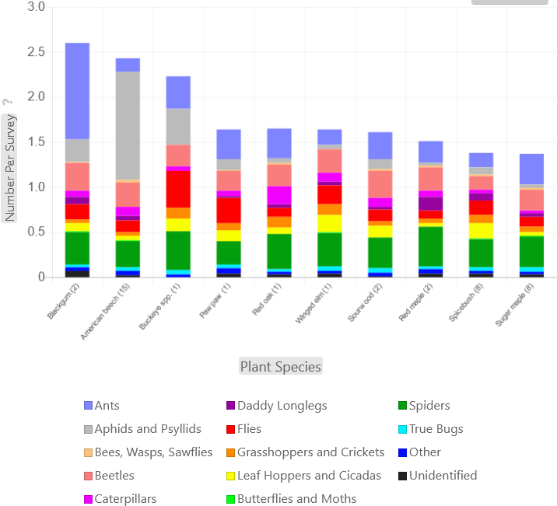
What have we learned?
The abundance of bird food varies A LOT from place to place!
And with host plant species.
Caterpillar Density

Slide 14
What have we learned?
The timing and abundance of bird food varies A LOT between years!
Caterpillar Phenology
North Carolina Botanical Garden

Slide 15
What have we learned?
The timing and abundance of bird food varies A LOT between years!
Caterpillar Phenology
North Carolina Botanical Garden

Slide 16
What have we learned?
The timing and abundance of bird food varies A LOT between years!
Caterpillar Phenology
North Carolina Botanical Garden

Slide 17
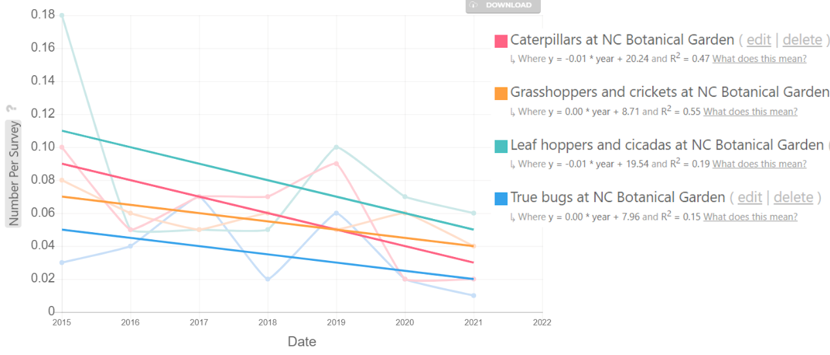
What have we learned?
Is bird food declining in general?
More in some places than others?
Trends

Slide 18
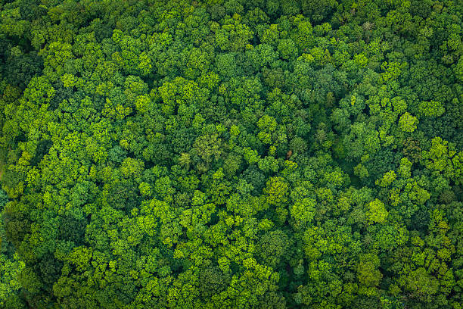
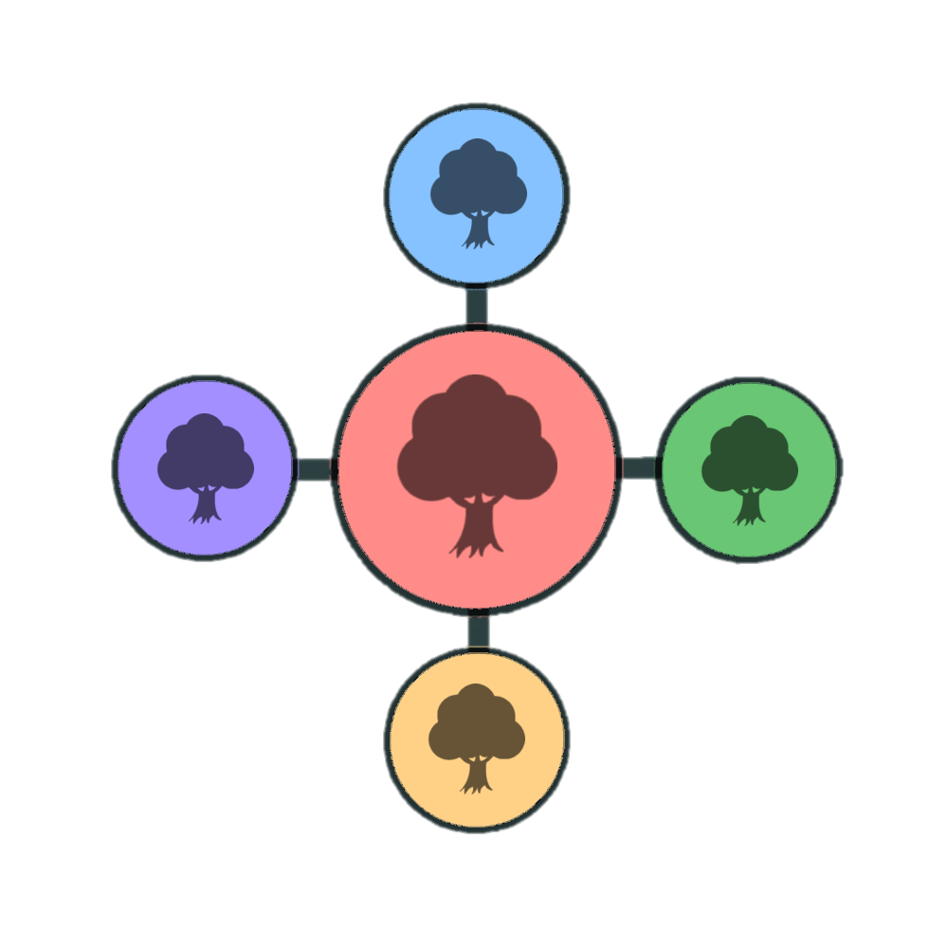

Setting up a site
Suggested set up for nature centers/schools:
At least 30 survey trees (6 circles); allow 2.5 person-hours
Weekly monitoring from May - July
Survey “circle”, a group of 5 trees

Slide 19
Setting up a site
Suggested set up for home/backyard:
At least 10 survey trees (2 circles); allow <1 person-hour
Spatial layout is flexible
Survey “circle”, a group of 5 trees

Slide 20
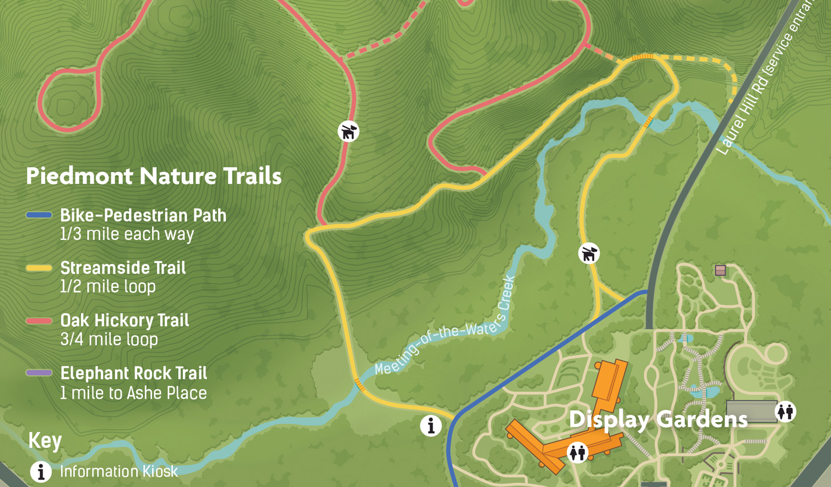
Example at NC Botanical Garden:
40 surveys in 8 groups along Streamside Trail
5 m
foliage
arthropod
survey
=
Weekly surveys from
late April - August

Slide 21
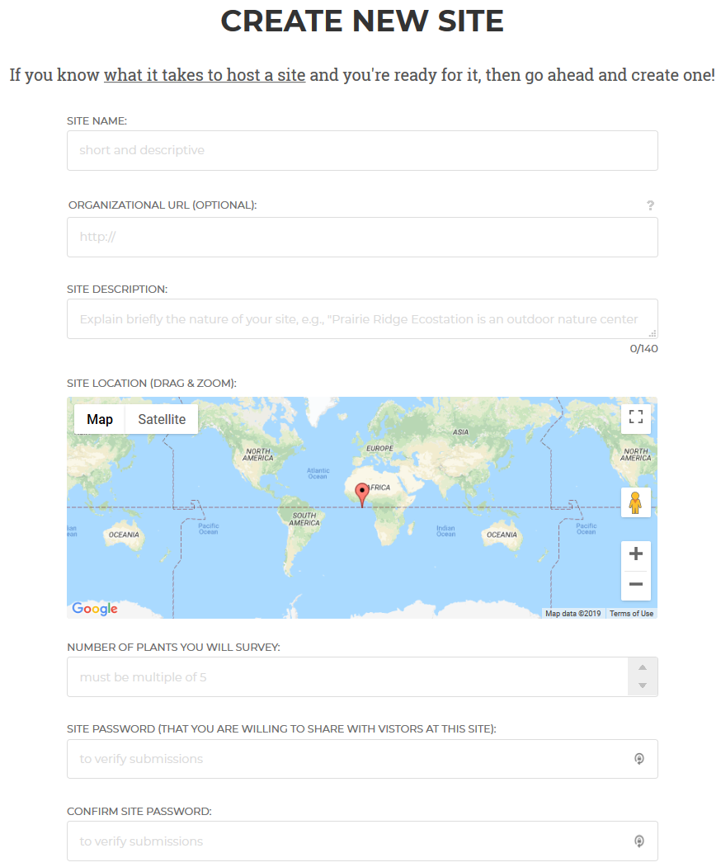
Create a Site
No permission required!
First, create an account. Then,
Website > My Account > Create New Site
https://caterpillarscount.unc.edu

Slide 22
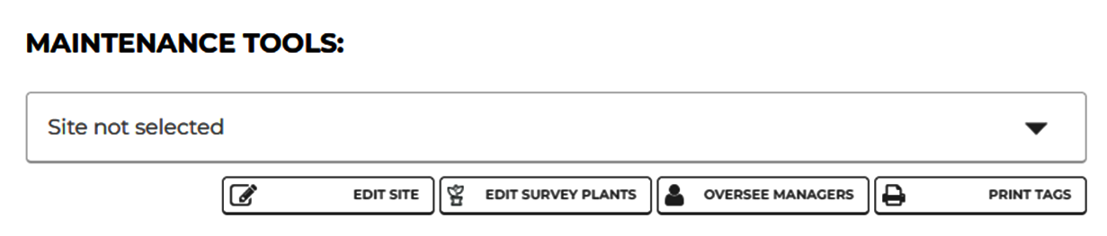
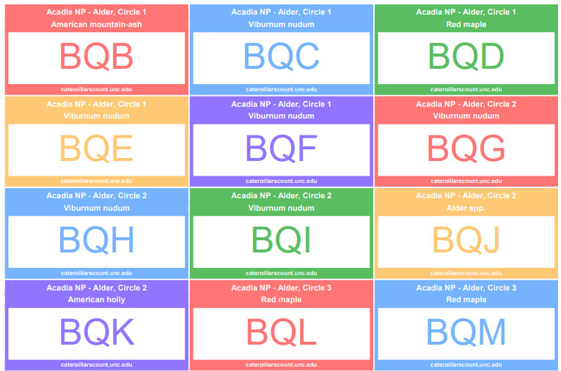
Create a Site

Slide 23
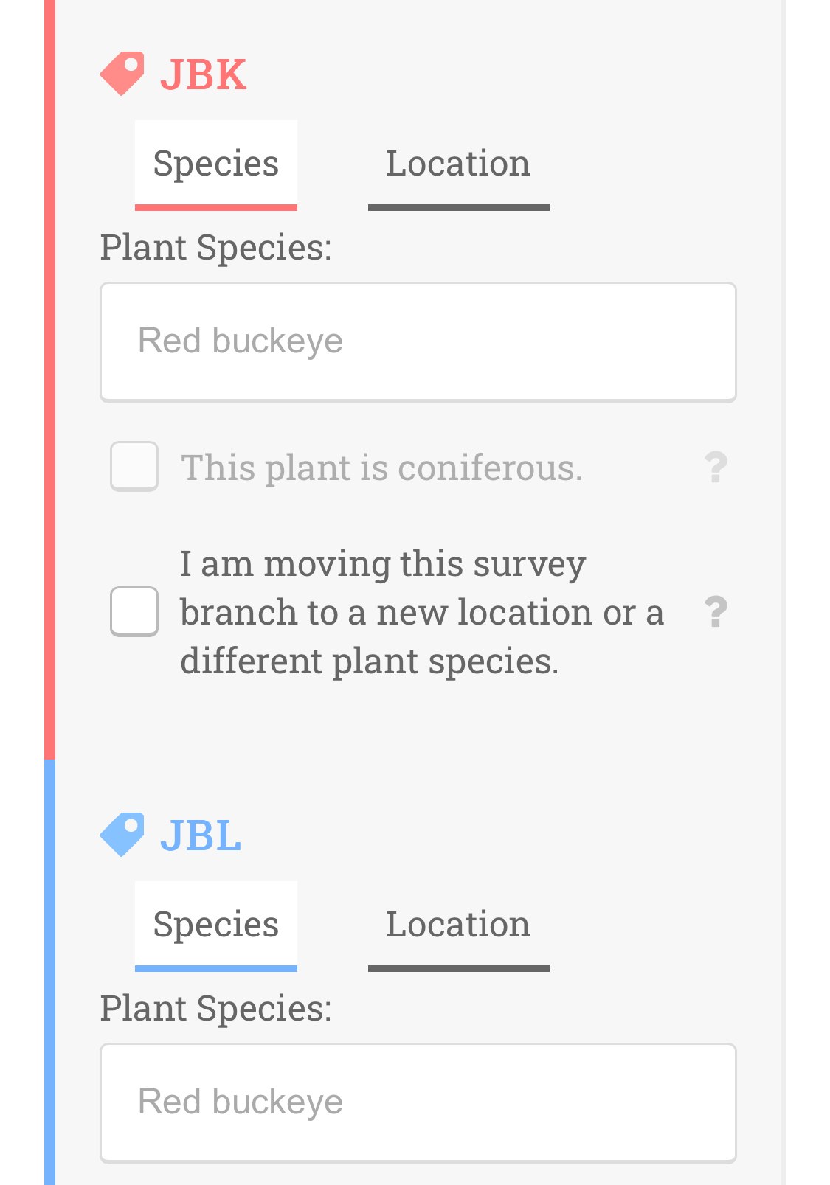
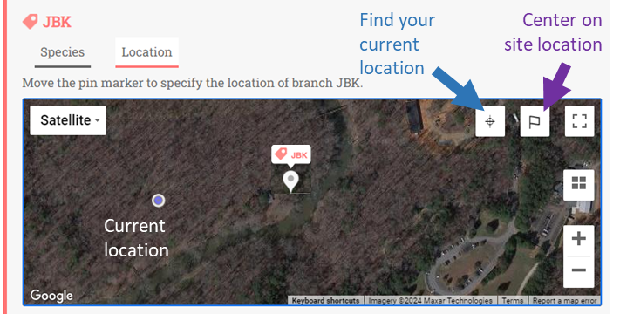
Create a Site
Specify plant species of survey branches
Map survey branches

Slide 24
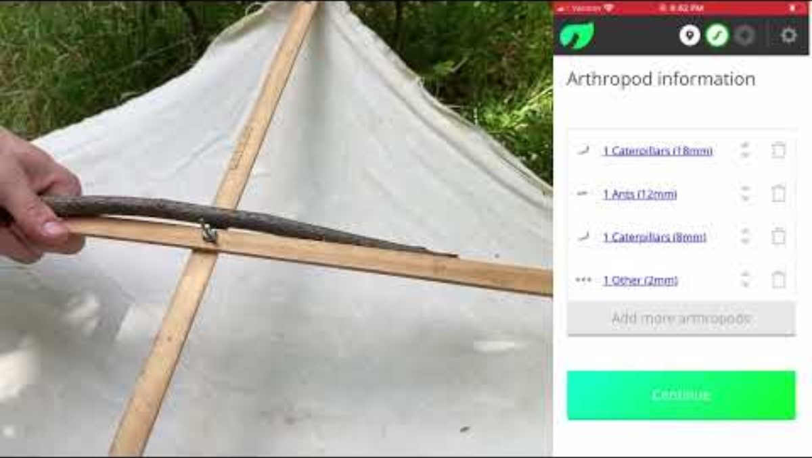
How to participate
Conducting surveys: Beat sheet survey (2-3 min each)
https://youtu.be/rV_4bi417uQ

Slide 25
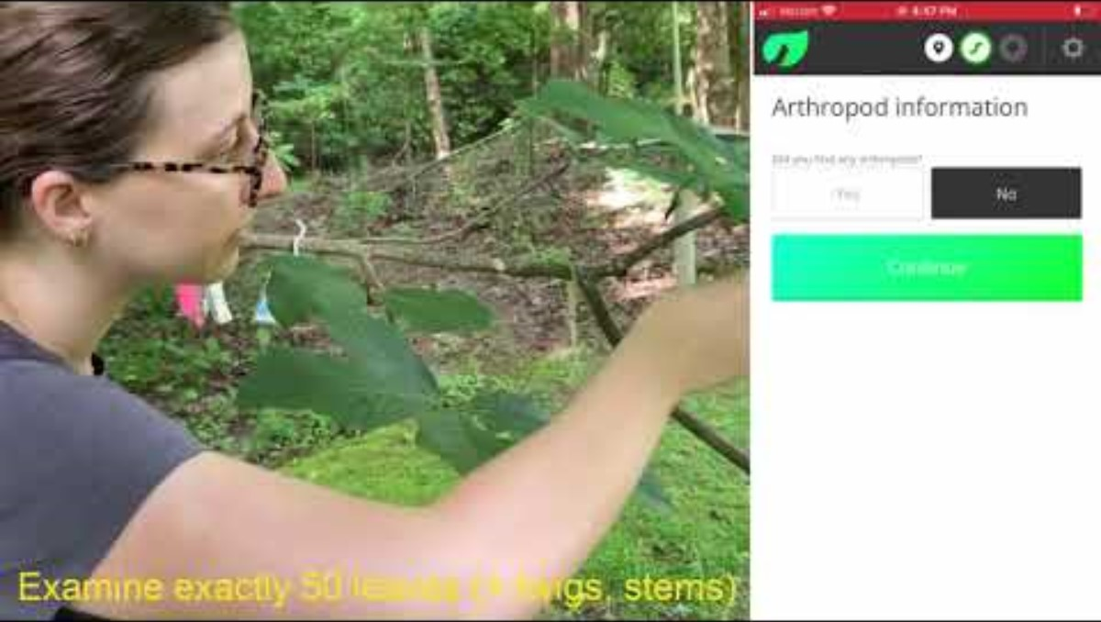
How to participate
Conducting surveys: Visual survey (~5 min each)
https://youtu.be/FnbC3XC2has

Slide 26
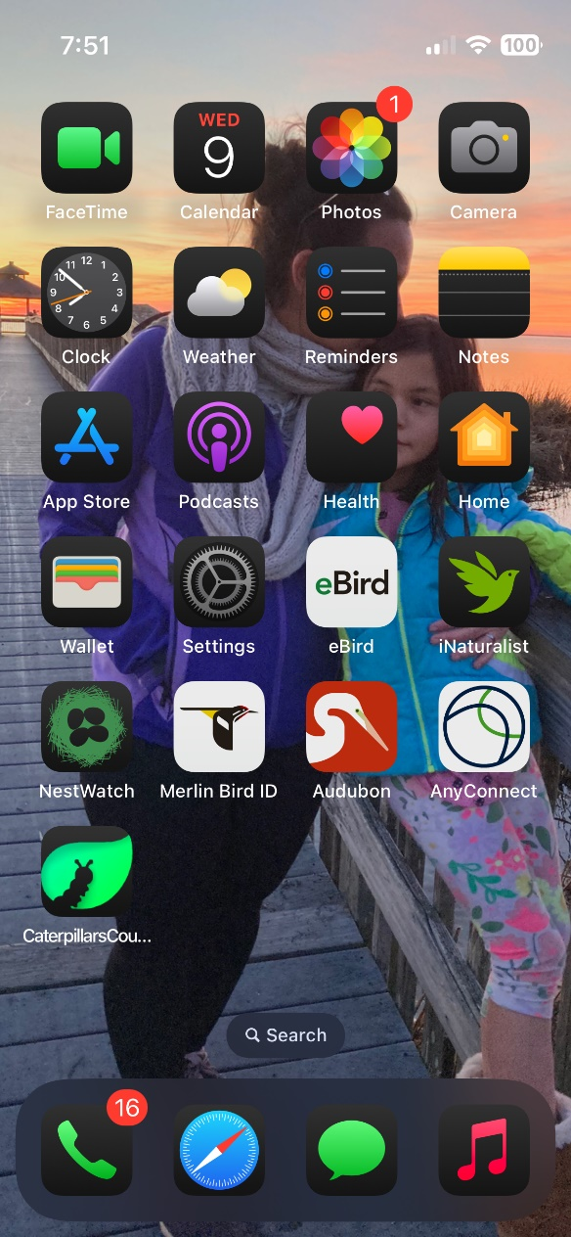
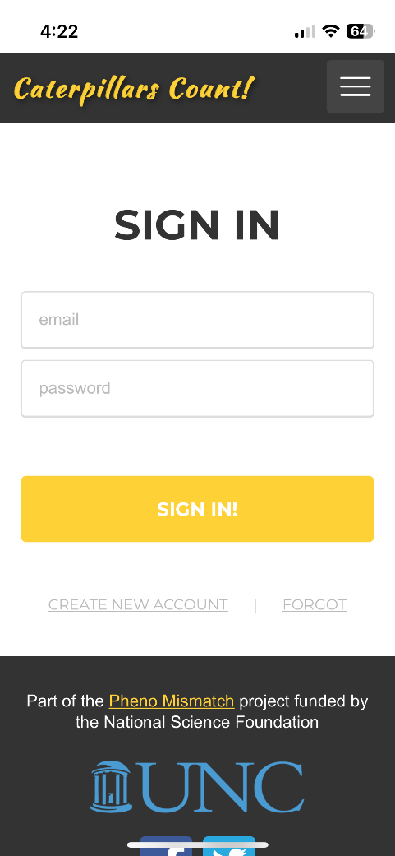
Create account / Sign in
Data submission
Install website bookmark on your home screen
Works like a normal “app”
Works in offline mode!

Slide 27
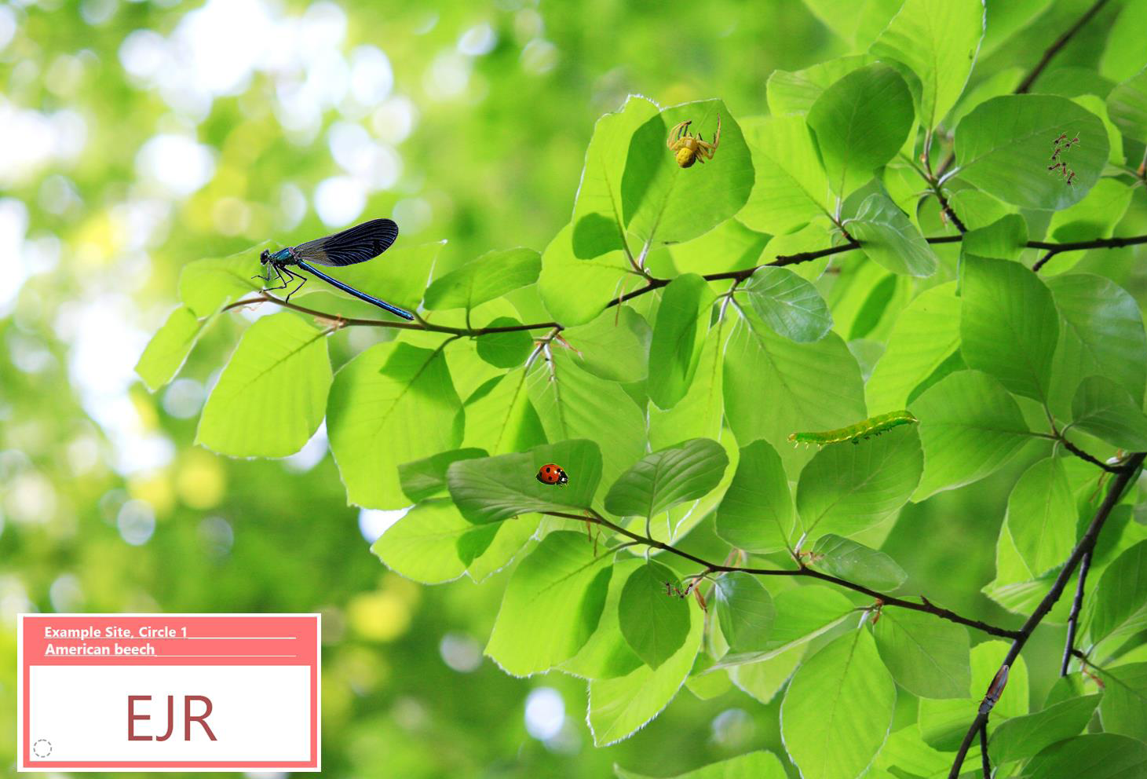
Create account / Sign in
Data submission
For this test branch, the password = test

Slide 28
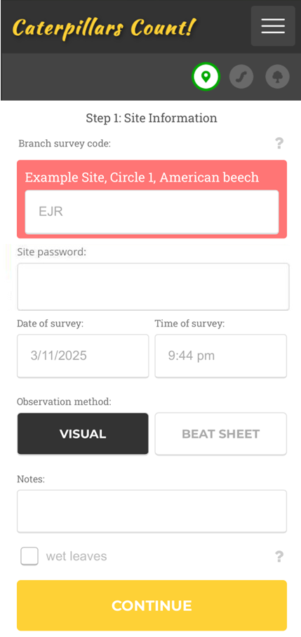
Create account / Sign in
Data submission
Enter unique 3-letter survey code

Slide 29
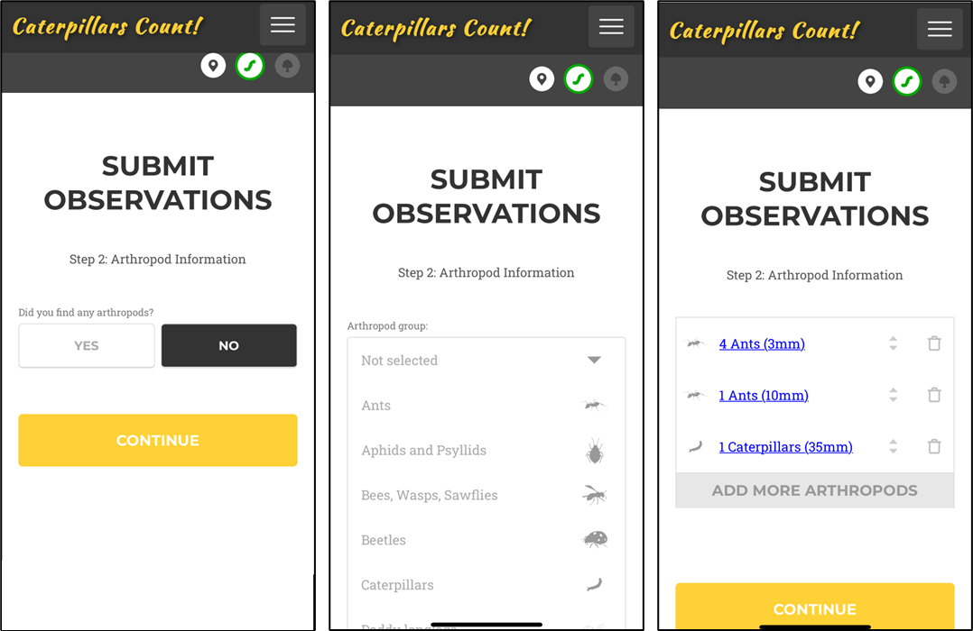
Data submission

Slide 30
Data submission

Slide 31
Data submission

Slide 32
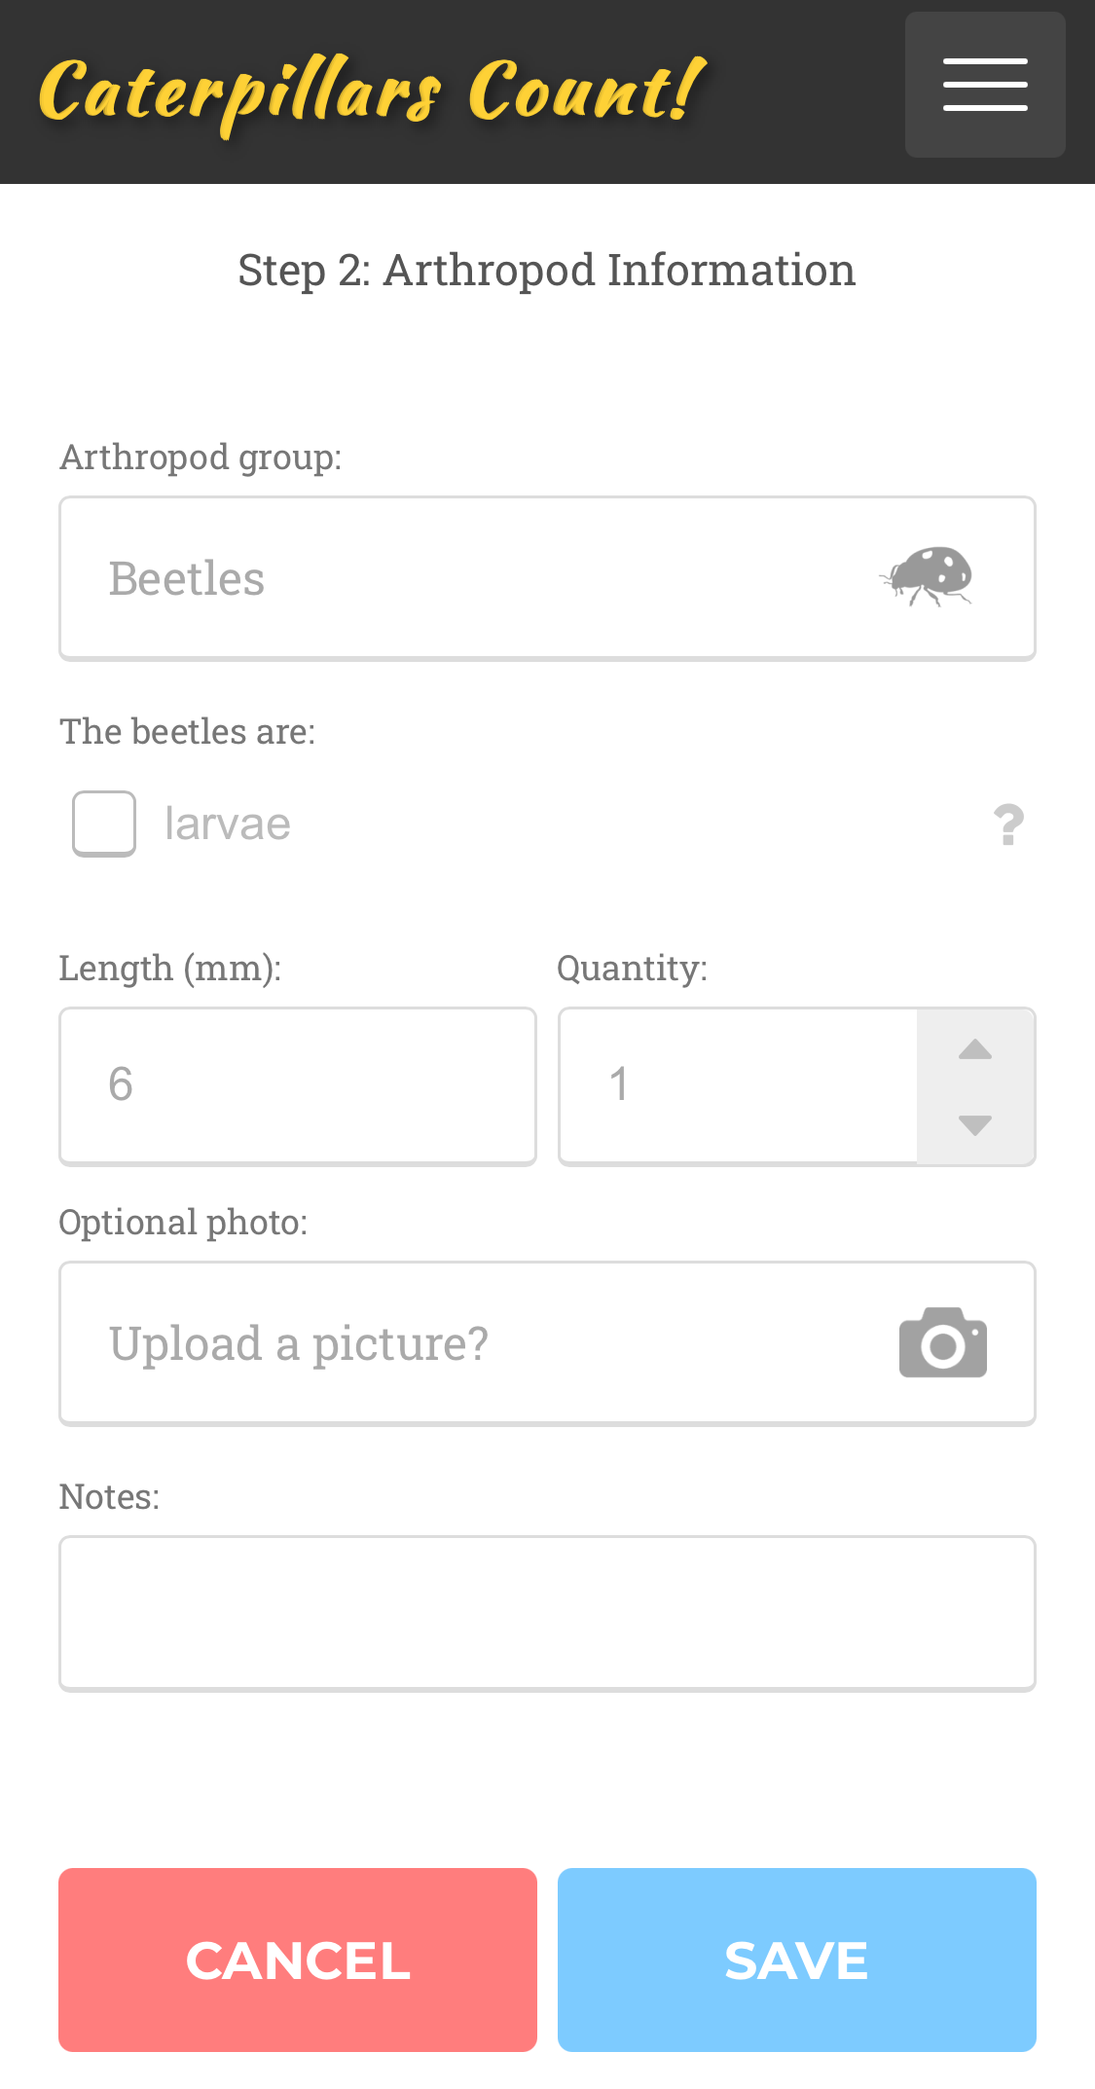
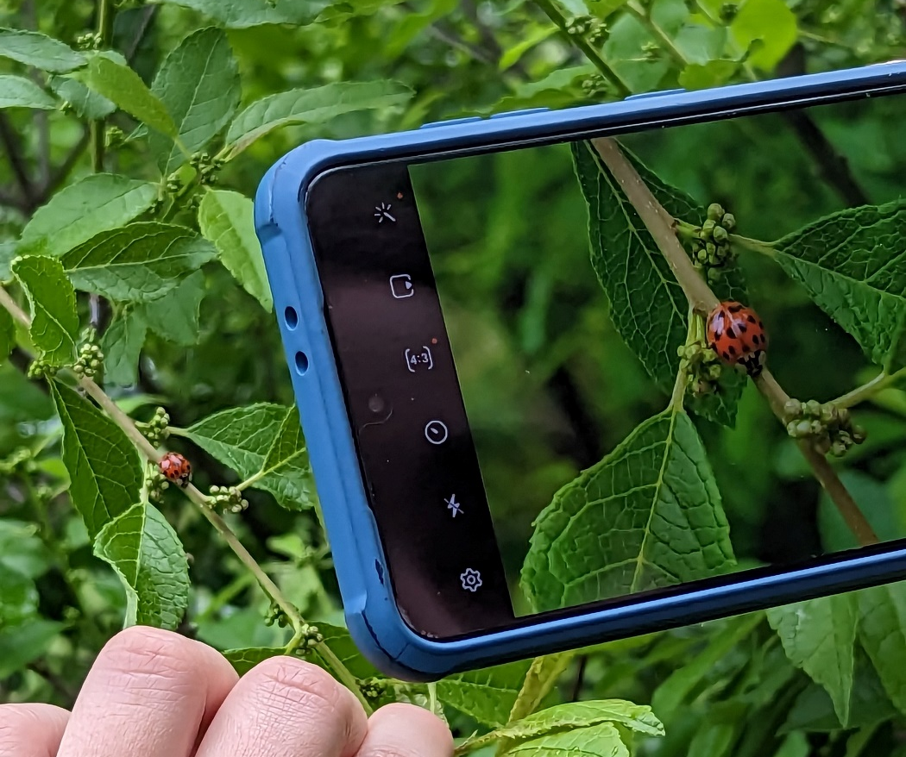
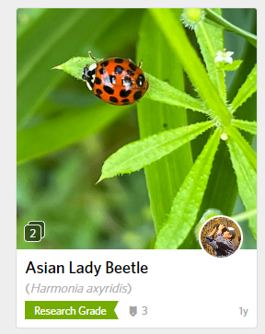
Optionally submit a photo…
Data submission
which gets sent to iNaturalist for potential identification

Slide 33
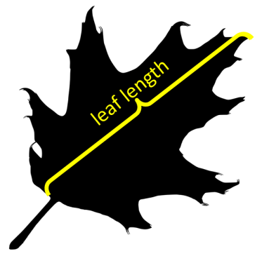
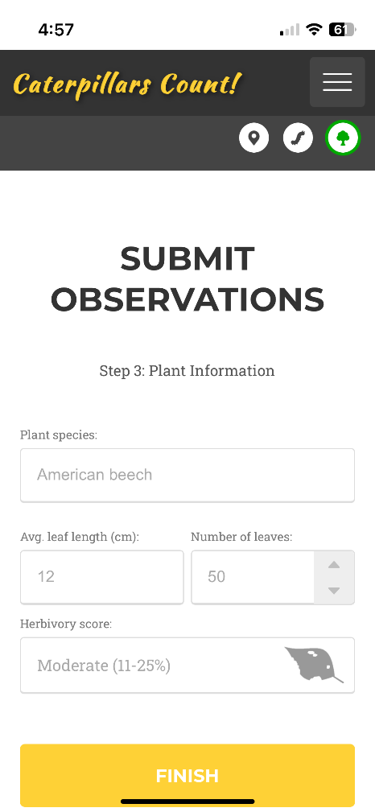
Data submission

Slide 34
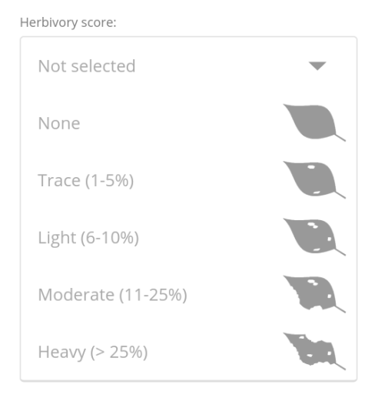
Data submission

Slide 35
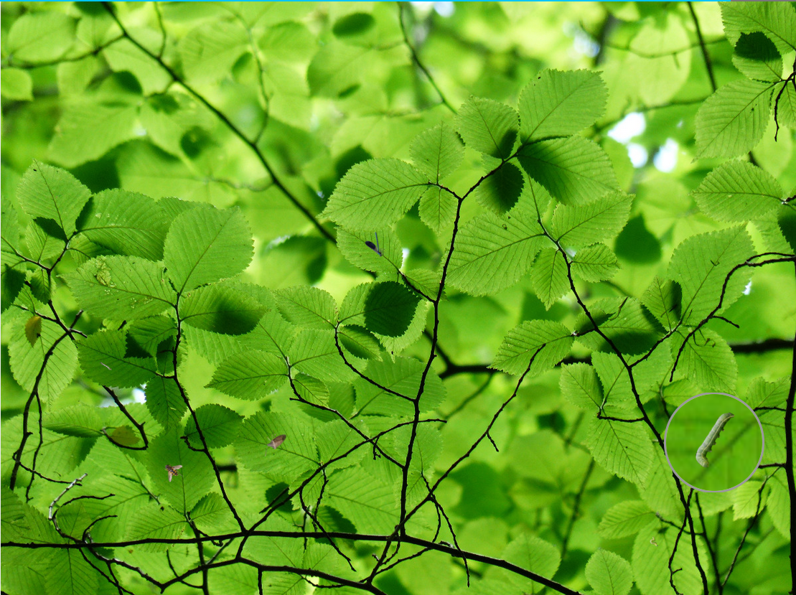
Virtual Survey
Play our virtual survey game to get practice
finding bugs on a branch
identifying them to order
estimating their length in millimeters
https://caterpillarscount.unc.edu/virtualSurvey

Slide 36
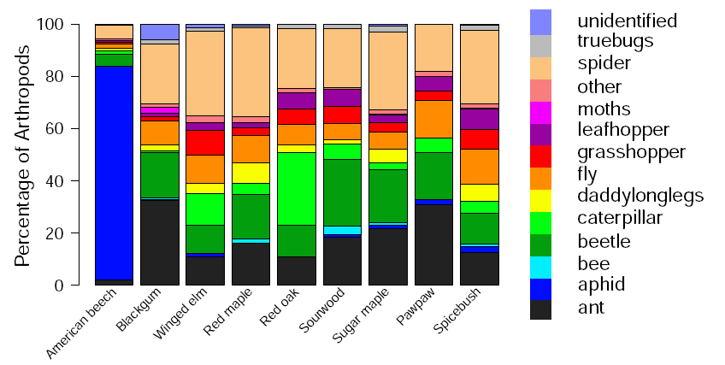
https://caterpillarscount.unc.edu/mapsAndGraphs
Data Visualization Tools
User Stats Dashboard
https://caterpillarscount.unc.edu/userDashboard
Resources page
https://caterpillarscount.unc.edu/resources

Slide 37
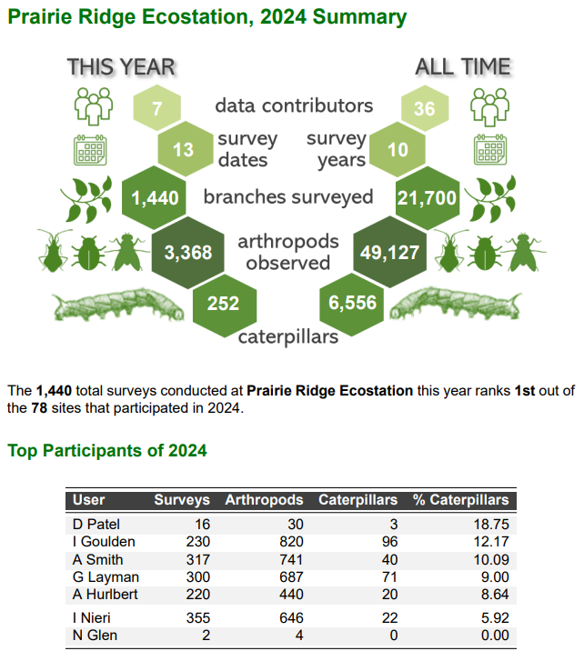

Annual Site Report

Slide 38

Annual Site Report

Slide 39

Annual Site Report

Slide 40

Annual Site Report

Slide 41

Join Us!
Sign up at caterpillarscount.unc.edu
Questions?
Email caterpillarscount@gmail.com
Dr. Allen Hurlbert, Project Leader
Funded by the National Science Foundation

